Slide 1
Oracle – User – Meeting
Oracle Datenbase & Oracle - APEX
Christine Apfel
Lusine Yakovleva
Harald Falkenberg
Hamburg, 05.02.2020

Slide 2
Oracle-User-Meeting
Agenda
Organisation
ULA – Unlimited License Agreement
View – our goals for 2020….
Questionnaire
Oracle RAC 19c Migration
Informations & Events
OAISys (internal DESY Tool for the Oracle-Service)
Websites
Events
APEX 19.2 Migration
APEX 19.2 Features

Slide 3
Organisation
How are we positioned?

Slide 4
New IT Group for databases and applications
IT has changed a bit internally
due to the increased importance of databases and the growing number of in-house APEX applications a new group of IT for database application and database services has formed.
Main Topics are:
Oracle-Database
APEX-Application development
Other Databases, maybe in a service (must be set up)
For a better manage 2 service addresses:
oracle.service@desy.de
apex-application.service@desy.de
We will start a survey to determine which databases have which meaning at DESY or XFEL.
Example: Our Learn Management System ILIAS Currently 2 different setups:
DESY (training.desy.de) and
XFEL (training.xfel.eu)

Slide 5
Oracle DSM – Software Deployment
New packages are available in the DSM
Oracle Full Client 19.3 32-Bit
Oracle Full Client 19.3 64-Bit
Oracle Instant Client 19.3.0.0 32-Bit
Oracle Instant Client 19.3.0.0 34-Bit
Oracle SQL Developer 19.2 64-Bit
All clients are provided in the DSM They have to be installed by the user!
An automatic update is forced for the SQL developer
the new clients can also be used for the old RAC
Please update your client software soon

Slide 6
ULA – Unlimited Licence Agreement

Slide 7
ULA
since 29th April 2019 - DESY ULA – Unlimited License Agreement for Oracle
period of validity : 2 years (ends 29th April 2021)
for an agreed product bundle and for a certain time we have the right to install and use an indefinite number of product
at the end of the agreed contract period a so-called certification of the Oracle ULA takes place
we will check how often a particular product has been installed and used
the number determined licenses is fixed
constant support contract

Slide 8
ULA – Product list
Agreed bundle
Inventory:
Each product is counted separately
Oracle Database Enterprise
Oracle Real Application Clusters
Oracle Partitioning
Oracle Spatial and Graph
Oracle Advanced Security
Oracle Diagnostics Pack
Oracle Tuning Pack
Oracle Advanced Compression
Oracle Database In-Memory
Oracle Multitenant
Oracle Database Lifecycle Management Pack
Oracle WebLogic

Slide 9
What does it mean for us
This year!
Setup different stages (e.g. test and production separately)
Using our ULA product bundle
Virtualization
Implement new requirements, e.g. Replication with Data Guard – that means database installations outside of our data center → higher level of operational security

Slide 10
What does it mean for you
If this is of interest to you,
contact us!
You already have an Oracle Database installation?
Make it legal - register them with us so that they are counted for licensing
If you want to operate test servers yourself, in order to be better positioned in communication with an external service provider
you need your own licenses e.g. for later setups? You can create licenses for your group
Pitfall: Please think about later server expansions the installations should not lose their validity if you have to change to new hardware!
You/your group would be responsible for hardware/virtual environment incl. the operating system
Assistance in the administration of this Databases cannot be managed by us, or only to a limited extent, in exceptional cases.

Slide 11
ULA - Inventory
Registration and management of these licenses only via the Oracle service! We cannot count installations that we don’t know!
Each product in our product bundle is counted separately
Relevant for the count: number of cores
IMPORTANT: Only what has been included in our inventory until February 2021 is counted. After that, new installations are only possible if the corresponding licenses were generated beforehand OR new licenses have to be obtained!
Why February 2021? We also need time to prepare
the report for Oracle

Slide 12
Plans for this year
Data Guard / virtualization

Slide 13
Oracle RAC 19c
Our new Cluster

Slide 14
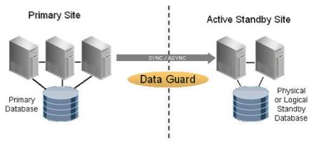
Data Guard - Replication
One of our ULA products
For security reasons, it will be necessary to secure the possible failure of our data center, so that even in the event of a failure, important Data can be accessed. Required by e.g. SAVE group.
Our current plan: 2 additional locations
Data Guard is an extension of the database management system, which allows the operation of a standby database
With Data Guard it is possible to send all data changes to a spatially separate database. This can then be planned (switchover) or take over if the primary database fails (failover).
It is possible to connect both physical and logical standby databases to the primary database.

Slide 15
New Application Server (virtualization and splitting)
The cluster is getting old….
For security reasons, our plan is to replace the application server with 2 virtual clusters. We currently have a 3 node cluster on hardware.
2 clusters because we want to / have to separate external and internal "traffic" - this is also a request from D4
Virtually, in order to get the maximum benefit from the ULA.
Forms:
Forms 12c (12.2.1.4.0 - Released September 2019)
Oracle BI Publisher Integration in Forms 12c
Reports:
The end of reports has been decided.
Switching to the BI publisher is recommended
Licenses are available
FORMS:
Last Statement of direction: https://www.oracle.com/a/tech/docs/oracleformssod.pdf
REPORTS:
Last Statement of direction: see Linklist

Slide 16
Questionnaire

Slide 17
Oracle RAC 19c
Our new Cluster

Slide 18
Oracle RAC 19c Migration

Slide 19
Why bother?
Migration of DESY DB
database version 12.1.0.2 is going out of support
server hardware needs to be replaced
increased load on server
new requirements of security, separation
bringing the ULA in use
prepare the Oracle database service for future requirements

Slide 20
Oracle at DESY
Timeline

Slide 21
Das „alte“ Setup

Slide 22
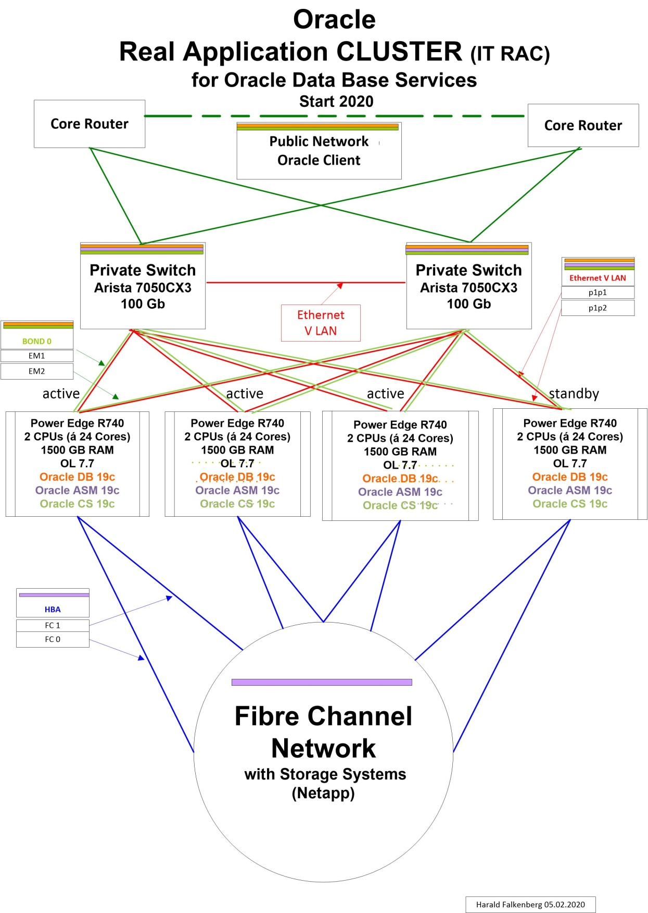
Das „neue“ Setup

Slide 23
Changes
What will change for DESY DB?
Database version: 12.1 -> 19c
Database characterset: WE8ISO8859P1 → AL32UTF8
Database media encryption: non TDE → TDE (Transparent Data Encryption)
Database operation: Non-CDB → CDB/PDB (Multitenant)
Database options: cur. state → cur. state + Advanced Compression, in Memory, Multitenant, Advanced Analytics
Client version: 12.1 → 19c
No support for client version: < 12.1
Same changes will be follow for other databases: BPM, EDM, GIS, IAM
Remains unchanged:
DNS names in Sql*Net files
Client Sql*Net configuration: tnsnames.ora, sqlnet.ora
APEX version and web access path

Slide 24
Character set change
Steps to check correct Oracle client setup
in SQL Plus: select 'ä ü ö' from dual;
in SQL Plus: create table test_table (text varchar2(100) ); insert into test_table (text) values ('sqlplus ä ü ö');
in SQL Plus: select text from test_table;
in SQL Developer: insert into test_table (text) values ('sqldeveloper ä ü ö');
in SQL Developer: select text from test_table;
in SQL Plus: select text from test_table;
Character set change in DESY DB
WE8ISO8859P1 → AL32UTF8
!!! client machine coding matters !!!
Check Oracle client NLS_LANG parameter setting
Check client machine coding
on Windows see: CodePage
on Linux see: env setting (LANG/LC_CTYPE)
Special cases: NLS_LANG parameter can be different to OS setting for utilities/programs!sqlloader, apache/httpd, java, python, perl, ...

Slide 25
Client Connection to an Oracle RAC (19c)

Slide 26
Configuration
Standard Sql*Net files at DESY
Important SQL*Net file content:
tnsnames.ora:
# connect to DB service on DESY DB:
desy_db.desy.de =
(DESCRIPTION =
(ADDRESS_LIST =
(ADDRESS = (PROTOCOL = TCP)(HOST = dbsrv01.desy.de)(PORT = 1521))
(ADDRESS = (PROTOCOL = TCP)(HOST = dbsrv02.desy.de)(PORT = 1521))
(ADDRESS = (PROTOCOL = TCP)(HOST = dbsrv03.desy.de)(PORT = 1521))
(LOAD_BALANCE = yes)
)
(CONNECT_DATA =
(SERVER = DEDICATED)
(SERVICE_NAME = desy_db.desy.de)
(FAILOVER_MODE =
(TYPE = NONE)
(METHOD = BASIC)
(RETRIES = 180)
(DELAY = 5)
)
)
)
Distributed:
on Windows by DSM
on Linux by puppet/AFS
on sync and share in folder oracle-software
sqlnet.ora:
# parameter for secure data transfer
SQLNET.ENCRYPTION_CLIENT = ACCEPTED
SQLNET.CRYPTO_CHECKSUM_CLIENT = ACCEPTED

Slide 27
Schedule
Schedule of migration DESY DB in 2020
Affected database services:
desy_db, gisfms_db, h1_db, xfel_db
Amount of affected users in DESY registry (resource Oracle): 740
Post migration tasks for DESY DB by IT in 2020:
extension of HA (High Availibity) concept by Data Guard
distribution of new tnsnames.ora, sqlnet.ora files
migration other DB service will be scheduled individually: bpm_db, dms_*_db, edm_db, gis_db, gpm_db, iam_db, wbt_db and more
test of migration: | february – march
user test period: | march – april
final migration: | may – june

Slide 28
User Tasks
What each user has to do in the migration process:
In advance:
de-register unused accounts
bring invalid objects (Indexes, Function, Procedures) in valid state
bring Oracle client on version 19c: full/instant, jdbc, odbc
check SQL*Net settings: tnsnames.ora, sqlnet.ora, jdbc connect string
check NLS_LANG settings on client machine
register Oracle account and applications in OAISYS
On test database
check data on test database
check application, PL/SQL
check result of SQL statements
check performance of statements
email feedback of test results to: oracle.service@desy.de
follow test instructions which will be send to mailing list: oracle-user@desy.de
For migration: restart your application
no action is needed on user's Oracle client side on central maintained machines

Slide 29
Informations & Events

Slide 30
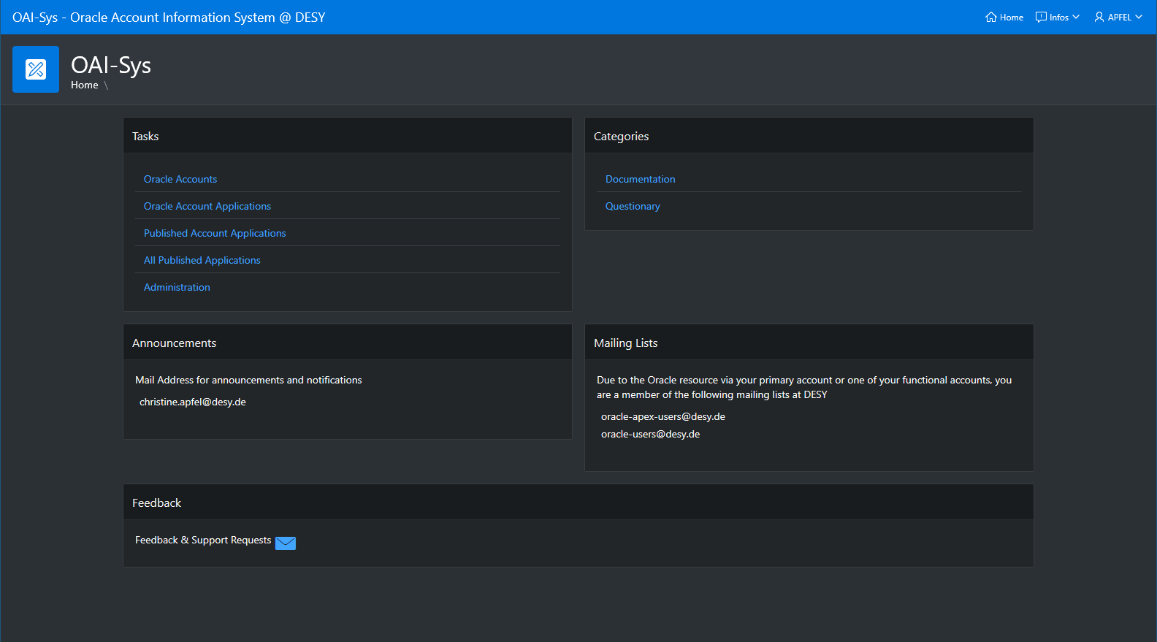
OAI-Sys
https://ias.desy.de/pls/apex/f?p=OAISYS
Our internal management tool

Slide 31
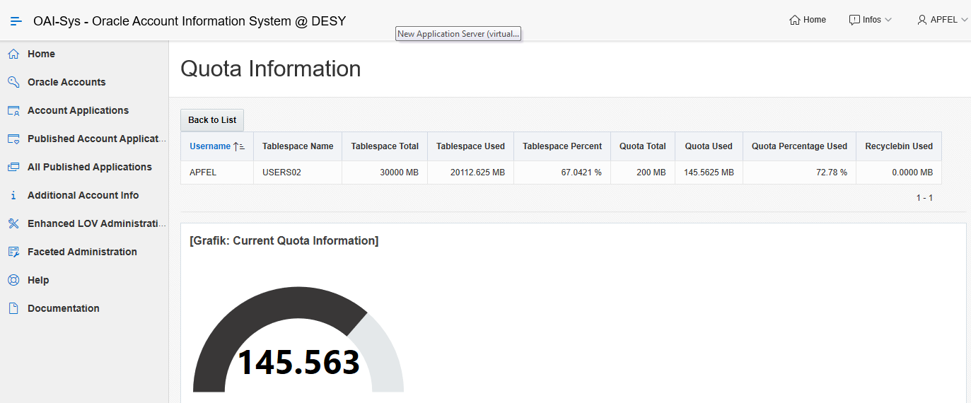
Account Information
Session, Quota and Attributes

Slide 32
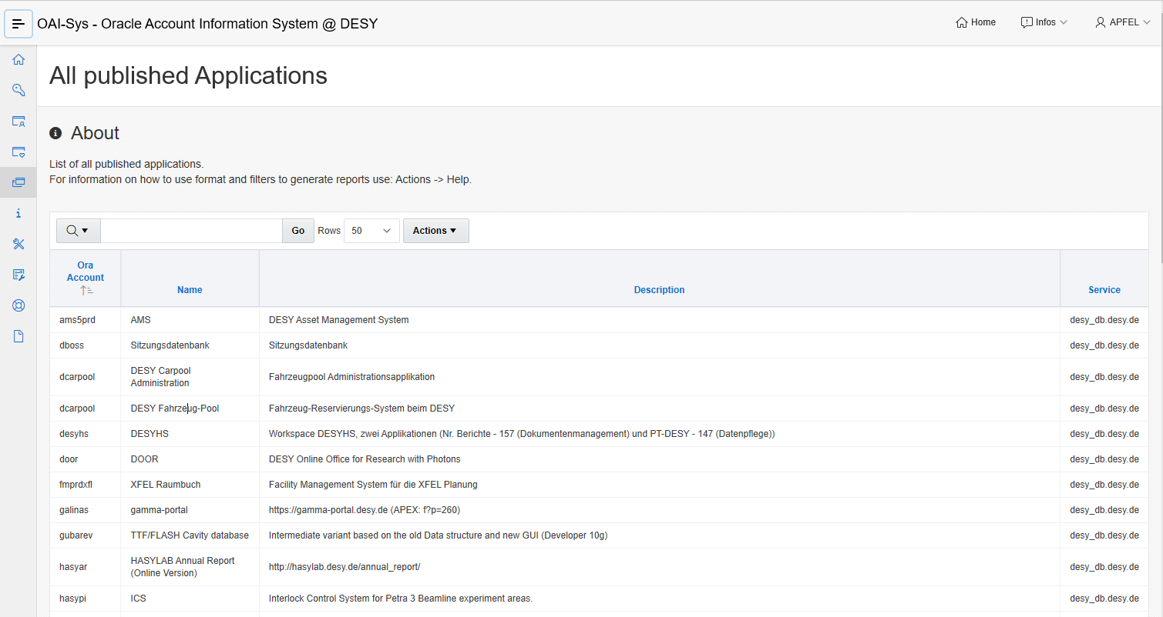
Register your Applications
registering your application helps us with maintenance announcements
we will expand this application, e.g. to manage outside activations of applications
Please send feature requests to:
oracle.service@desy.de or
apex-application.service@desy.de

Slide 33
APEX Connect 2020
Program see: https://programm.doag.org/apex/2020/#/schedule
Early bird discount until 25.03.2020!

Slide 34
DOAG 2020 Database
Progam: not available yet, please see https://datenbank.doag.org/de/home/

Slide 35
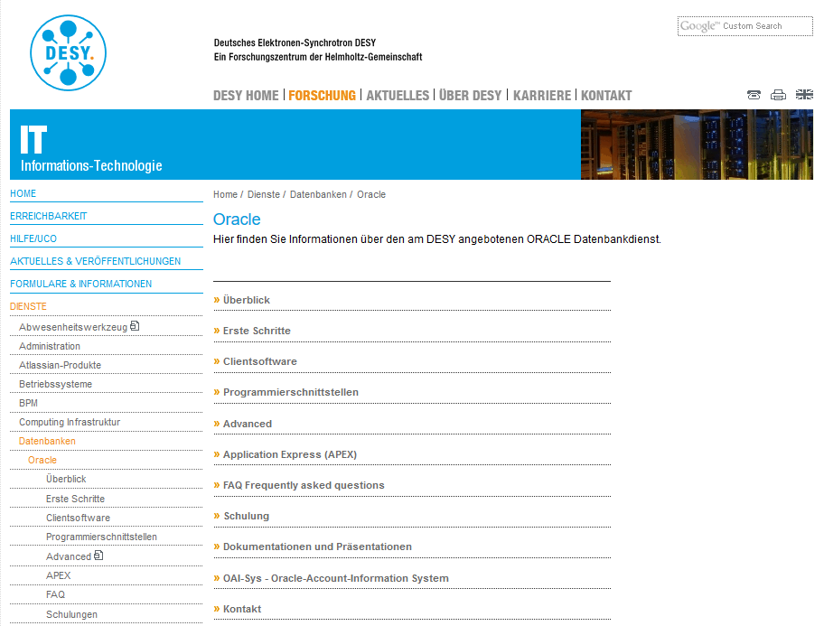
Our service under: it.desy.de
As part of the renewals in the Oracle environment, we have updated our website see: https://it.desy.de/dienste/datenbanken/ Please take a look around to report to oracle.service@desy.de if you miss any information there.
Currently only in german (sorry)
An English version will follow.

Slide 36
Link-List
OAI-Sys https://ias.desy.de/pls/apex/f?p=OAISYS
Oracle Forms Statement of Direction (October 2019) https://www.oracle.com/a/tech/docs/oracleformssod.pdf
Oracle Reports Statement of Direction (April 2019) https://www.oracle.com/technetwork/middleware/reports/downloads/oracle-reports-sod-3236098.pdf
Oracle APEX Statement of Direction https://apex.oracle.com/en/learn/resources/sod/

Slide 37
APEX Migration

Slide 38
APEX 19.2
Migrate your applications
Applications typically continue to run without errors, but browser updates, new Javascript libraries, etc. can also lead to side effects. The risk that an application "suddenly" contains errors is increasing.
APEX 19.2 has been available to you since January 14th, 2020
Applications will not updated automatically to version 19.2
Every application developer has to transfer his applications himself.
So…. Delete old unused applications!
APEX offers a migration assistant that queries the individual migration steps – these steps have to be followed
New features can only be used if applications are in the current version of the infrastructure
Applications managed by the APEX service such as EASY, IAM, JAG, DARF-DACHS and more, are migrated from the APEX service!

Slide 39
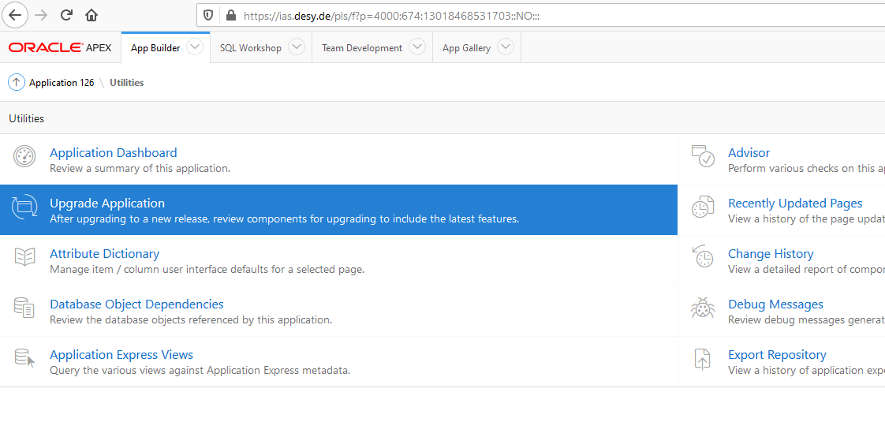
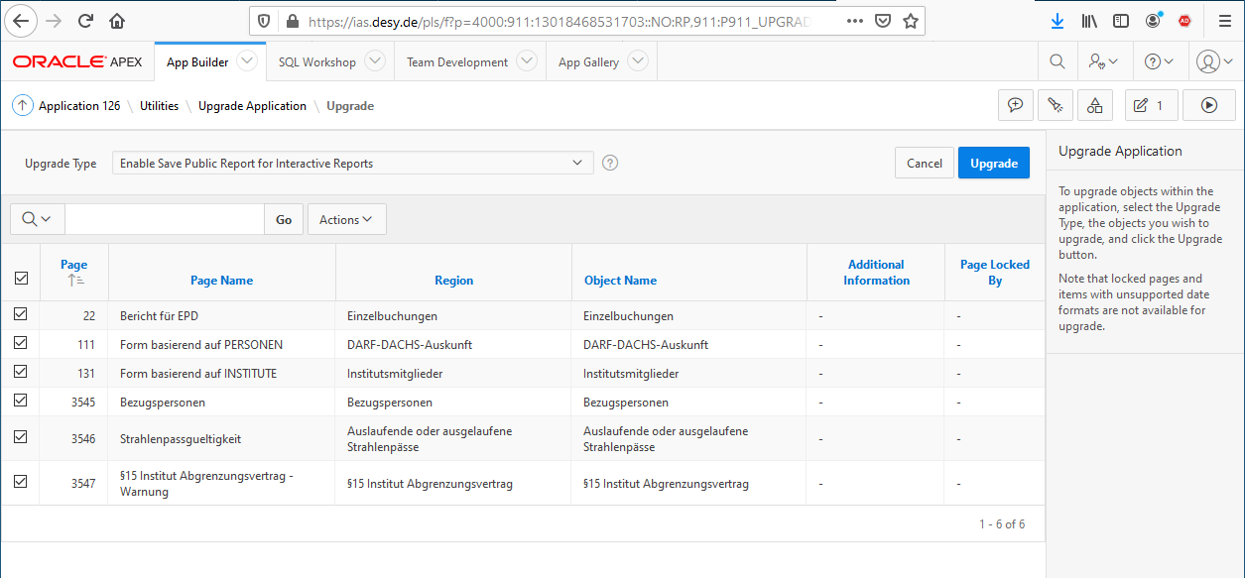
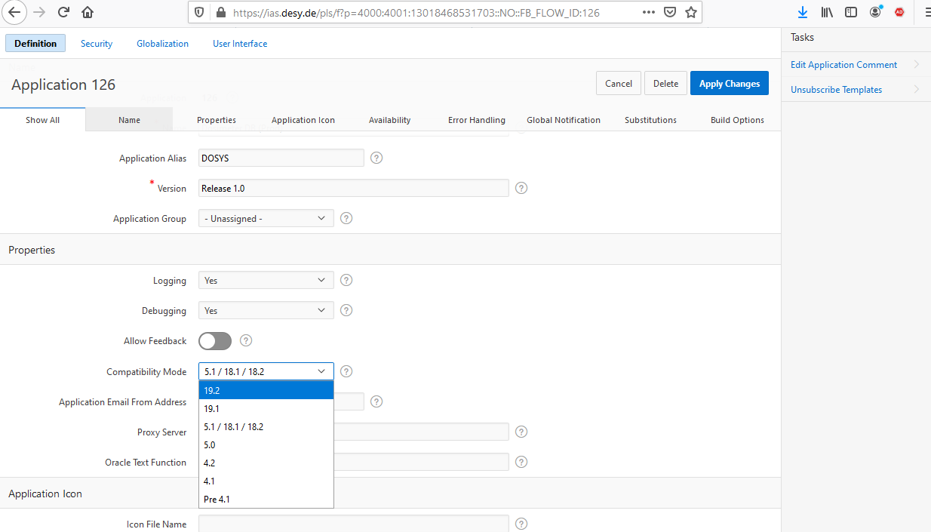
Migration Steps
Just a beginning
Don‘t forget to change the Compatibility Mode
See „Application Properties“

Slide 40
APEX – new Features
New Features and Pitfalls in APEX 19.2

Slide 41
Questions?

Slide 42
Thanks to you!

